Slide 1
Android Training
Building Your First App
http://developer.android.com/training/index.html
师文轩，13920561100，shiwenxuan2003@hotmail.com

Slide 2
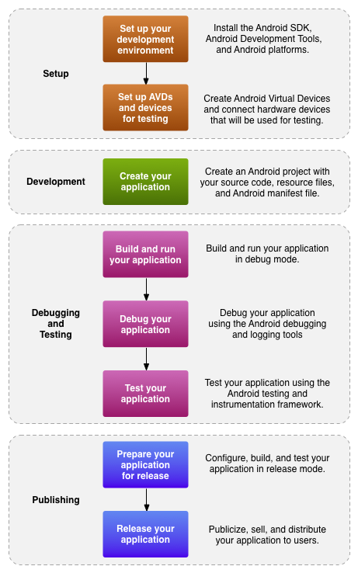
Introduction
Workflow

Slide 3
Essential command line tools
Android: Create and update Android projects and create, move, and delete AVDs.
Android Emulator: Run your Android applications on an emulated Android platform.
Android Debug Bridge: Interface with your emulator or connected device (install apps, shell the device, issue commands, etc.).

Slide 4
Third-party command line tools:
Ant: To compile and build your Android project into an installable .apk file.
Keytool: To generate a keystore and private key, used to sign your .apk file. Keytool is part of the JDK.
Jarsigner (or similar signing tool): To sign your .apk file with a private key generated by Keytool. Jarsigner is part of the JDK.

Slide 5
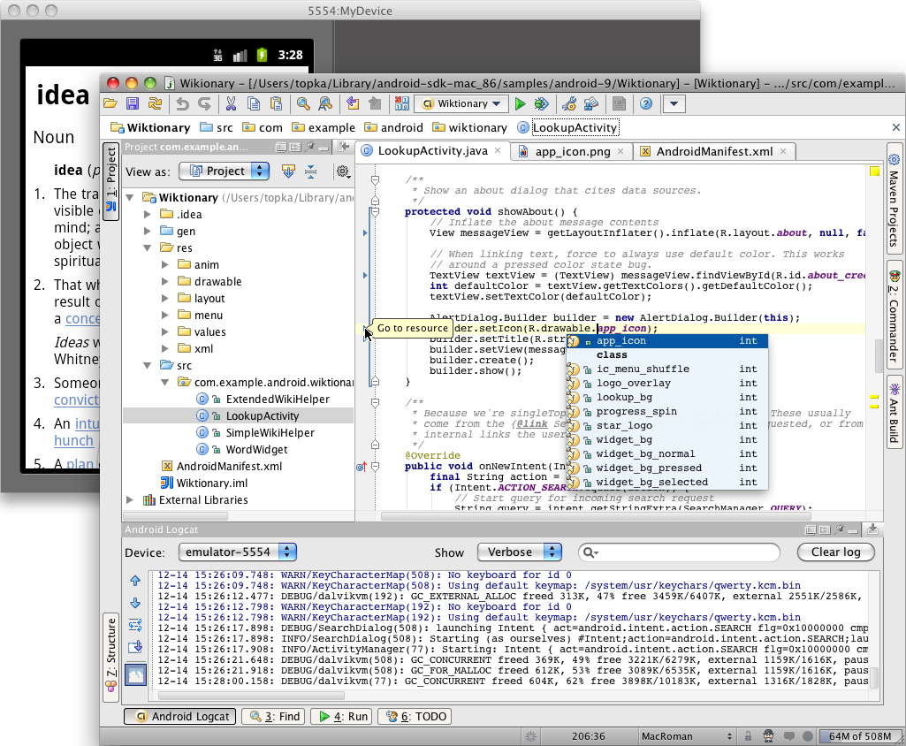
Other Third-Party Development Tools
Developing in IntelliJ IDEA

Slide 6
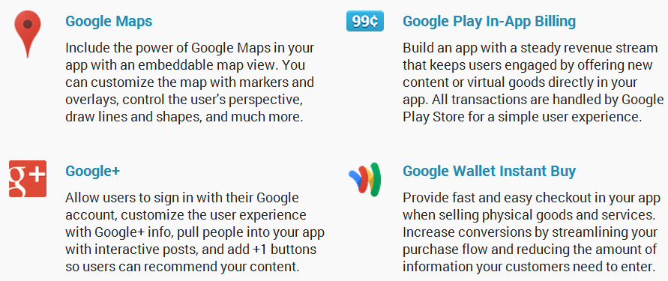
Google Services

Slide 7
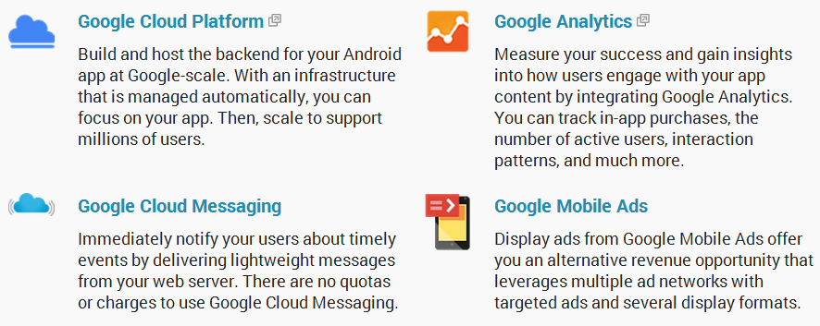

Slide 8

Design Principles
Enchant Me
Delight me in surprising ways
A beautiful surface, a carefully-placed animation, or a well-timed sound effect is a joy to experience.
Subtle effects contribute to a feeling of effortlessness and a sense that a powerful force is at hand.

Slide 9

Real objects are more fun than buttons and menus
Allow people to directly touch and manipulate objects in your app.
It reduces the cognitive effort needed to perform a task while making it more emotionally satisfying.

Slide 10

Let me make it mine
People love to add personal touches because it helps them feel at home and in control.
Provide sensible, beautiful defaults, but also consider fun, optional customizations that don't hinder primary tasks.

Slide 11
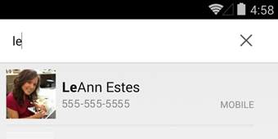
Get to know me
Learn peoples' preferences over time.
Rather than asking them to make the same choices over and over, place previous choices within easy reach.

Slide 12
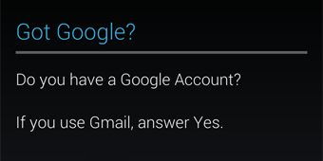
Simplify My Life
Keep it brief
Use short phrases with simple words.
People are likely to skip sentences if they're long.

Slide 13

Pictures are faster than words
Consider using pictures to explain ideas.
They get people's attention and can be much more efficient than words.

Slide 14
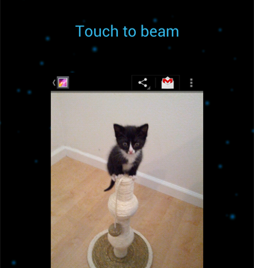
Decide for me but let me have the final say
Take your best guess and act rather than asking first.
Too many choices and decisions make people unhappy.
Just in case you get it wrong, allow for 'undo'.

Slide 15
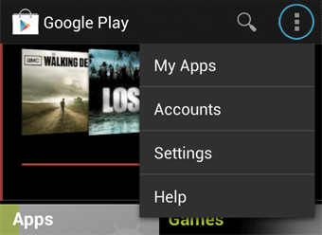
Only show what I need when I need it
People get overwhelmed when they see too much at once.
Break tasks and information into small, digestible chunks.
Hide options that aren't essential at the moment, and teach people as they go.

Slide 16
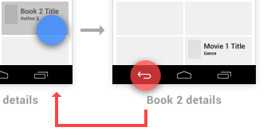
I should always know where I am
Give people confidence that they know their way around.
Make places in your app look distinct and use transitions to show relationships among screens.
Provide feedback on tasks in progress.

Slide 17
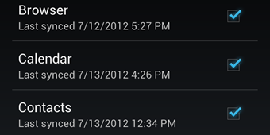
Never lose my stuff
Save what people took time to create and let them access it from anywhere.
Remember settings, personal touches, and creations across phones, tablets, and computers.
It makes upgrading the easiest thing in the world.

Slide 18
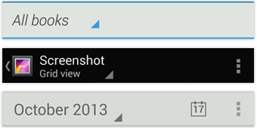
If it looks the same, it should act the same
Help people discern functional differences by making them visually distinct rather than subtle.
Avoid modes, which are places that look similar but act differently on the same input.

Slide 19
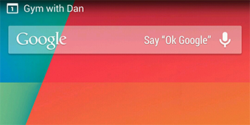
Only interrupt me if it's important
Like a good personal assistant, shield people from unimportant minutiae.
People want to stay focused, and unless it's critical and time-sensitive, an interruption can be taxing and frustrating.

Slide 20
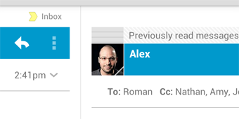
Make Me Amazing
Give me tricks that work everywhere
People feel great when they figure things out for themselves.
Make your app easier to learn by leveraging visual patterns and muscle memory from other Android apps.
For example, the swipe gesture may be a good navigational shortcut.

Slide 21
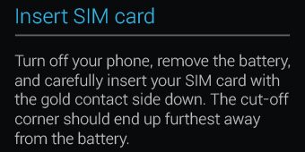
It's not my fault
Be gentle in how you prompt people to make corrections.
They want to feel smart when they use your app.
If something goes wrong, give clear recovery instructions but spare them the technical details.
If you can fix it behind the scenes, even better.

Slide 22
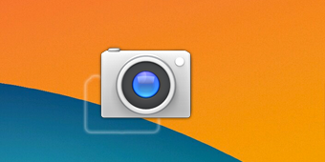
Sprinkle encouragement
Break complex tasks into smaller steps that can be easily accomplished.
Give feedback on actions, even if it's just a subtle glow.

Slide 23
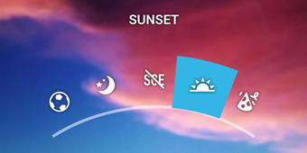
Do the heavy lifting for me
Make novices feel like experts by enabling them to do things they never thought they could.
For example, shortcuts that combine multiple photo effects can make amateur photographs look amazing in only a few steps.

Slide 24
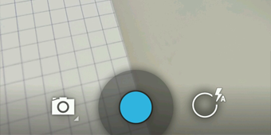
Make important things fast
Not all actions are equal.
Decide what's most important in your app and make it easy to find and fast to use, like the shutter button in a camera, or the pause button in a music player.

Slide 25
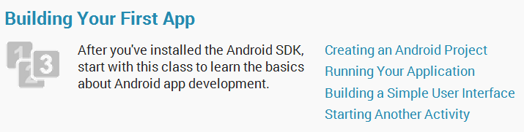
Building Your First App

Slide 26

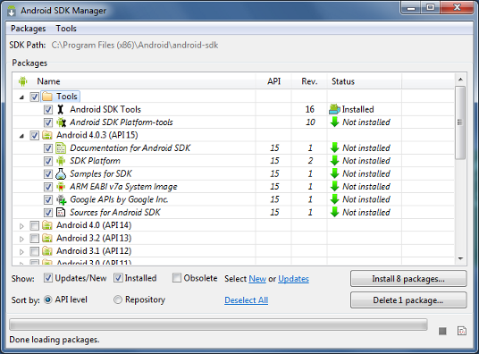
Prepare

Slide 27
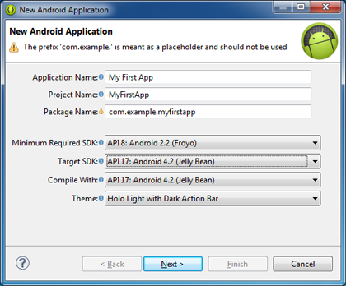
Creating an Android Project
Create a Project with Eclipse

Slide 28
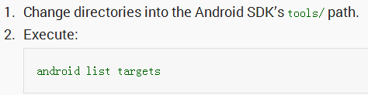
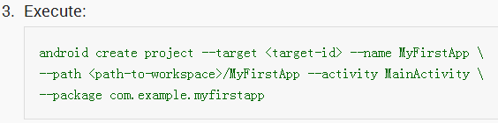
Create a Project with Command Line Tools

Slide 29
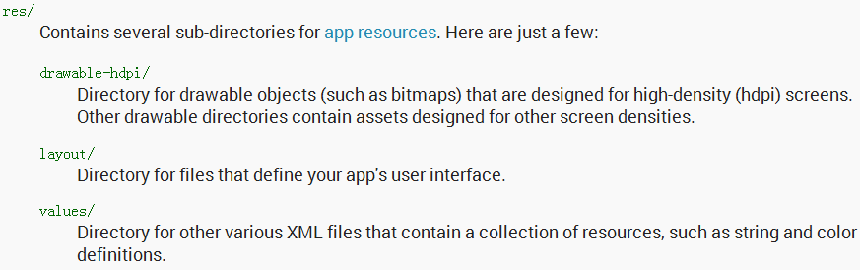
Running Your App

Slide 30
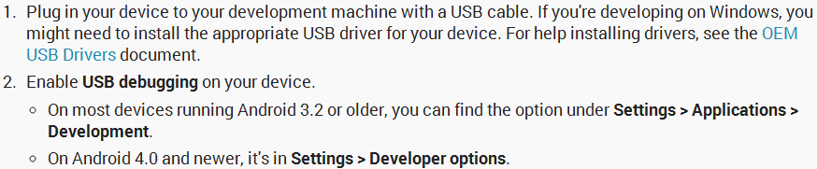
Run on a Real Device

Slide 31
To run the app from Eclipse

Slide 32
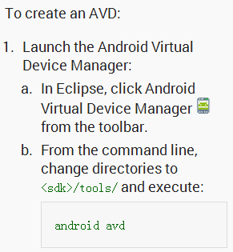
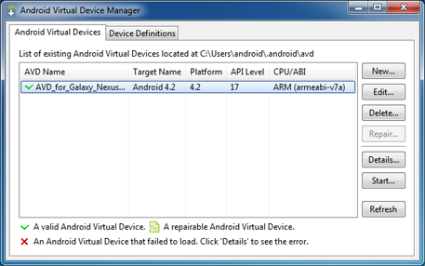
Run on the Emulator

Slide 33
To run the app from Eclipse

Slide 34
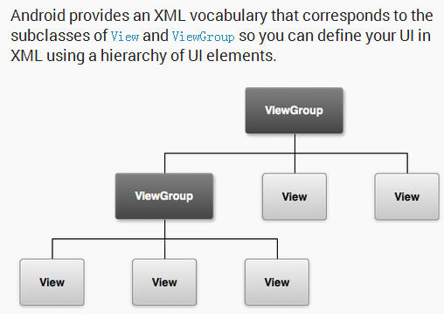
Building a Simple User Interface

Slide 35
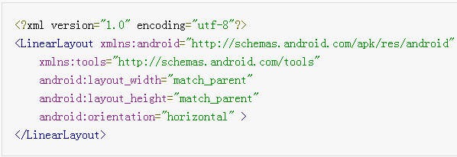
Create a Linear Layout
Open the activity_main.xml file from the res/layout/ directory.

Slide 36
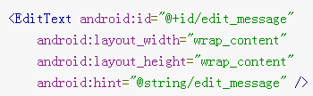
Add a Text Field
To create a user-editable text field, add an <EditText> element inside the <LinearLayout>.

Slide 37
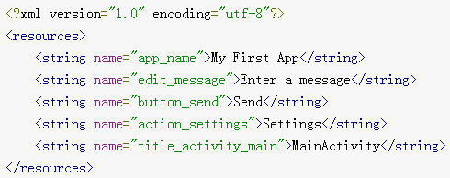
Add String Resources
By default, your Android project includes a string resource file at res/values/strings.xml.

Slide 38
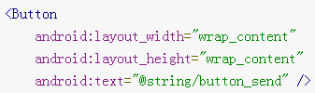

Add a Button
Now add a <Button> to the layout, immediately following the <EditText> element

Slide 39
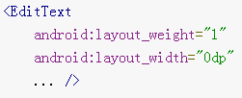

Make the Input Box Fill in the Screen Width

Slide 40
Source code(activity_main.xml)
<?xml version="1.0" encoding="utf-8"?> <LinearLayout xmlns:android="http://schemas.android.com/apk/res/android" xmlns:tools="http://schemas.android.com/tools" android:layout_width="match_parent" android:layout_height="match_parent" android:orientation="horizontal"> <EditText android:id="@+id/edit_message" android:layout_weight="1" android:layout_width="0dp" android:layout_height="wrap_content" android:hint="@string/edit_message" /> <Button android:layout_width="wrap_content" android:layout_height="wrap_content" android:text="@string/button_send" /> </LinearLayout>

Slide 41
Starting Another Activity
In this lesson, you’ll add some code to MainActivity that starts a new activity when the user clicks the Send button.

Slide 42
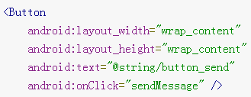
Respond to the Send Button
To respond to the button's on-click event, open the activity_main.xml layout file and add the android:onClick attribute to the <Button> element:

Slide 43

Open the MainActivity class (located in the project's src/ directory) and add the corresponding method:
This requires that you import the View class:

Slide 44
Build an Intent
Inside the sendMessage() method, create an Intent to start an activity called DisplayMessageActivity:

Slide 45
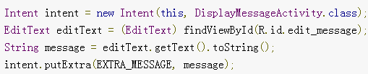
Inside the sendMessage() method, use findViewById() to get the EditText element and add its text value to the intent:

Slide 46
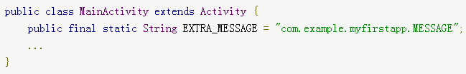
add the EXTRA_MESSAGE definition to the top of the MainActivity class:

Slide 47
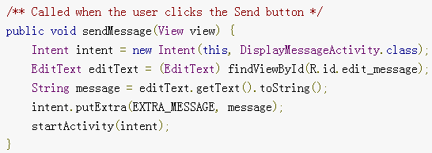
Start the Second Activity
With this new code, the complete sendMessage() method that's invoked by the Send button now looks like this:

Slide 48
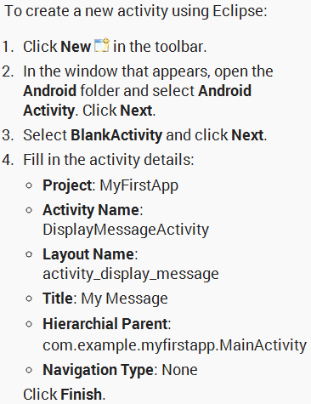
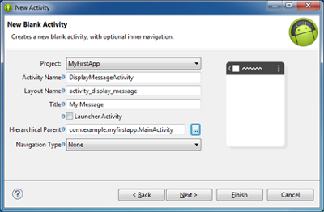
Create the Second Activity

Slide 49
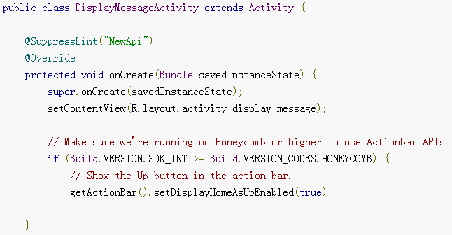
The DisplayMessageActivity class should now look like this:

Slide 50
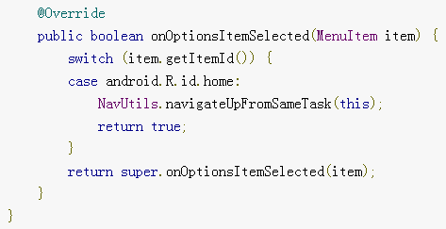

Slide 51
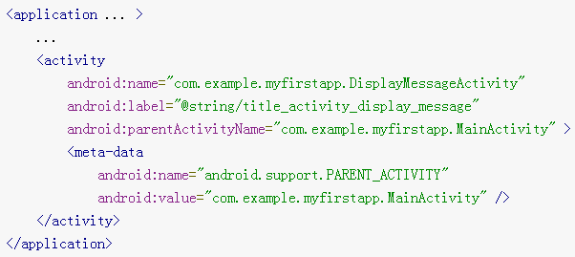
Add it to the manifest
All activities must be declared in your manifest file, AndroidManifest.xml, using an <activity> element

Slide 52

Receive the Intent
In the DisplayMessageActivity class’s onCreate() method, get the intent and extract the message delivered by MainActivity:

Slide 53
Display the Message
To show the message on the screen, create a TextView widget and set the text using setText(). Then add the TextView as the root view of the activity’s layout by passing it to setContentView().

Slide 54
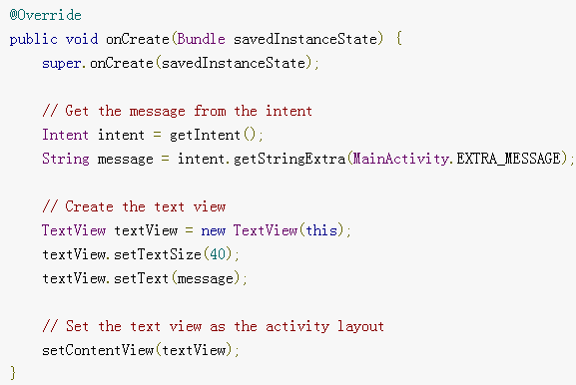
The complete onCreate() method for DisplayMessageActivity now looks like this:

Slide 55
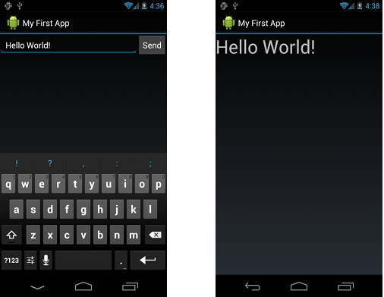
You can now run the app. When it opens, type a message in the text field, click Send, and the message appears on the second activity.

